Slide 1
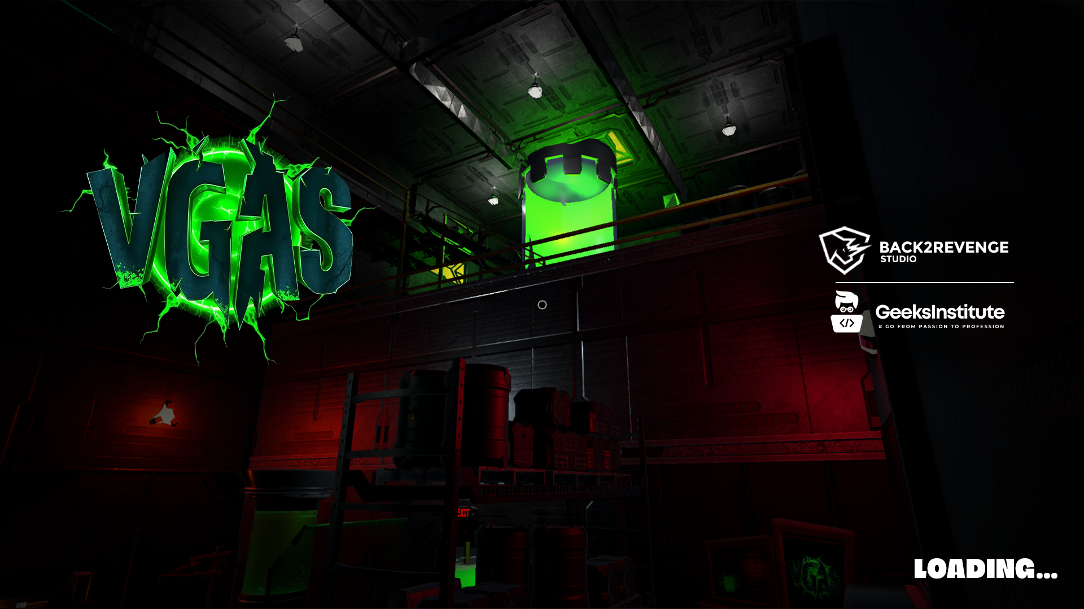

Slide 2

The LAST FLOOR
Choose between the clarity of a toxic death or the safety of a claustrophobic reality

Slide 3

GAME TITLE: V-Gas: The Last Floor
TAGLINE / HIGH CONCEPT: Survive the mutating V-Gas in a skyscraper laboratory before it consumes everything.
GENRE: 3D Action-Exploration / Horror
PLATFORM: PC
TARGET AUDIENCE / AGE RATING: Teen (13+) – PEGI 16 / ESRB T
PLAYER MODE: Single-player
RELEASE STATUS: Beta
GAME SYNOPSIS:
In a massive skyscraper laboratory, a mutating gas called V-Gas has turned the staff into grotesque monsters. You are a partially immune scientist navigating the facility from a first-person perspective, racing to climb floor by floor, evade mutated workers , solve puzzles. Survival requires quick thinking, combat, and exploration.
GAMEPLAY OVERVIEW:
GAMEPLAY OVERVIEW:
Navigate the lab in immersive first-person perspective
Engage in combat with mutated humans and security drones
Solve environmental puzzles to unlock access to upper floors
Explore each floor for clues, resources, and secrets
Manage tension with limited visibility, gas hazards, and enemy encounters

Slide 4
OPD
3Cs
Music Sound DIRECTION
REFERENCES
Moodboard

Slide 5

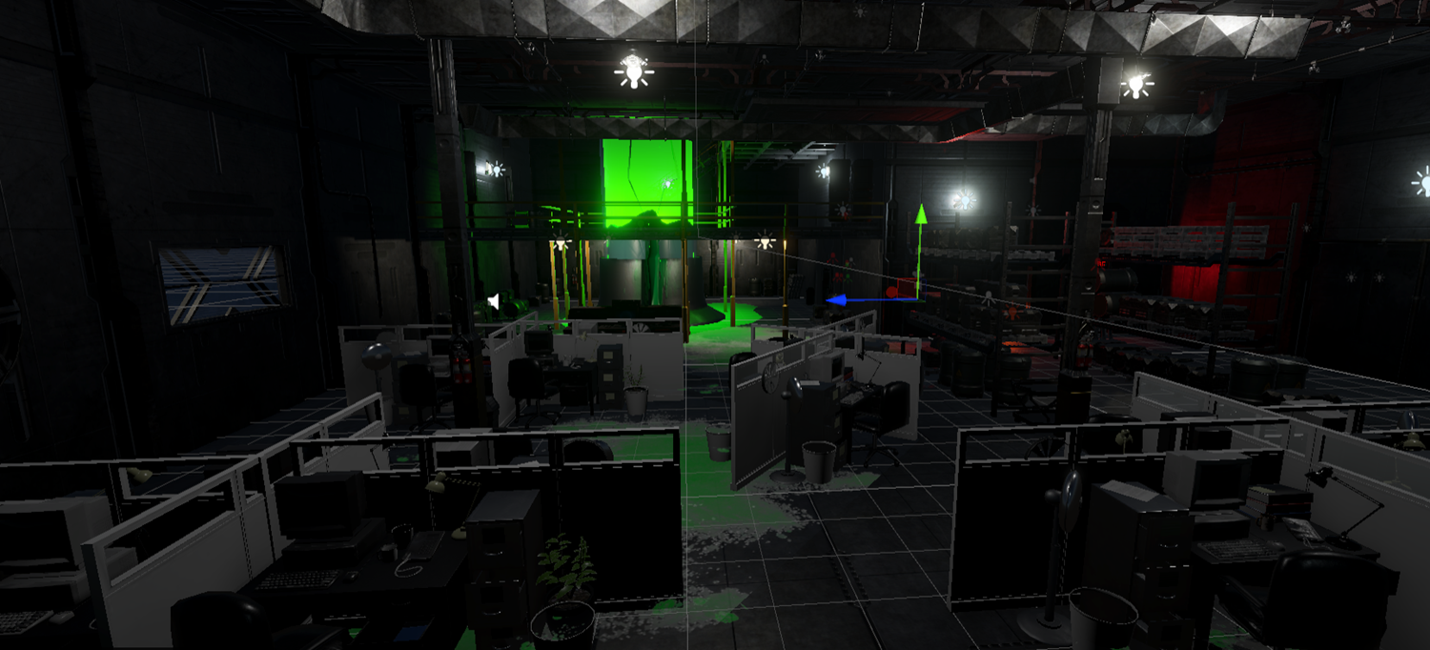
01
Music Sound DIRECTION
Ambient / Dark Ambient
Electronic / Synthwave

Slide 6
3Cs
Controls
WASD Move
The player controls a lone survivor navigating a hostile and mysterious environment. The character is designed to feel vulnerable but capable, emphasizing tension, survival, and decision-making. Player abilities evolve through exploration and progression.
Character
FPS
The player controls a lone survivor navigating a hostile and mysterious environment. The character is designed to feel vulnerable but capable, emphasizing tension, survival, and decision-making. Player abilities evolve through exploration and progression.
Camera
The camera is designed to enhance immersion and tension. A first-person perspective keeps the player fully engaged in the world, reinforcing realism, fear, and environmental storytelling while maintaining clear visibility during gameplay.

Slide 7
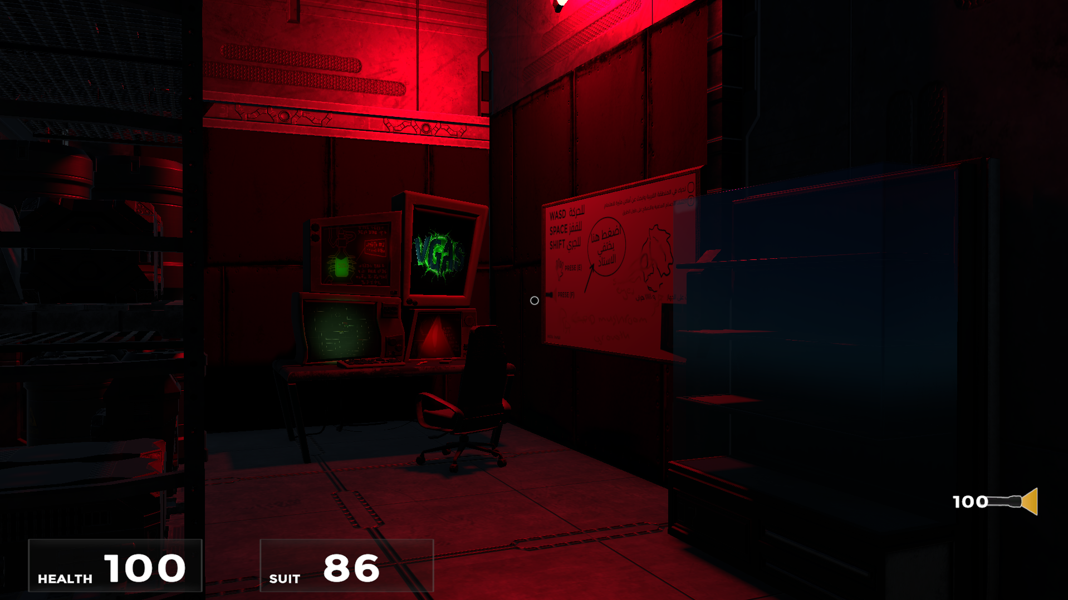
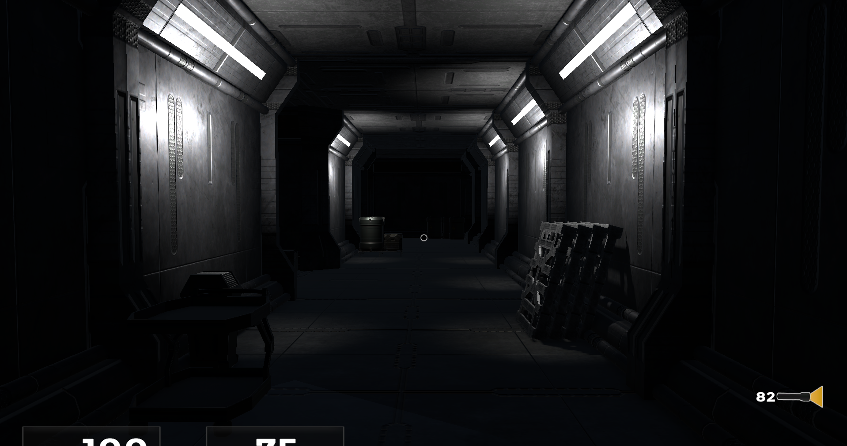
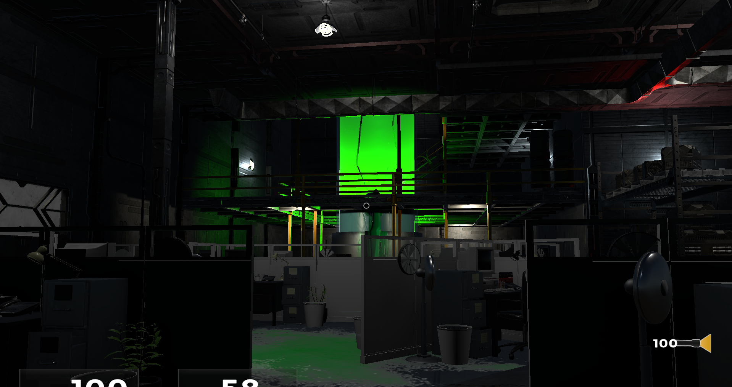
Moodboard

Slide 8




REFERENCES
Resident Evil 2019
The Last Of Us
The Mist 2007
Resident Evil 2002

Slide 9

USP
USP
V-Gas: The Last Floor is a first-person horror game where a deadly gas turns a skyscraper into a living threat. Instead of only fighting enemies, the player must survive the environment itself while climbing floor by floor to escape.

Slide 10









TOOLS
UNITY Engine 6
Used in Development
Visual Studio
Communication
BLENDER
Discord
Art & Assets
Audio & Music
FIGMA
Whatsapp
Audacity
Photoshop
Click

Slide 11


THE TEAM WORK
EL MEHDI HAMTE
OTMANE EL AYACHI
ABDOLLAH HANNACHE
STORY TELLING
Game Designer
Game Developer
Level Designer
3D Artist
Sound Designer &
CODING

